Slide 1
Week-7
Session-2
What is Marketing?
-What is marketing?
-Marketing mix (4Ps for product and 7Ps for service)
-The 5 eras/concepts of marketing - production, product, selling, marketing, societal marketing
-B2B and B2C markets

Slide 2
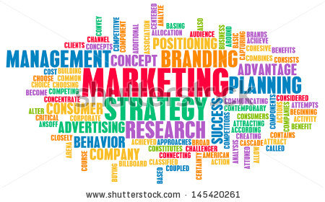
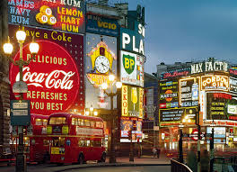

WHAT’S MARKETING?
*
What is Marketing?
*
LG1
Marketing -- activity, set of institutions and processes for creating, communicating, delivering, and exchanging offerings with value for customers, clients, partners and society at large. The
13-

Slide 3
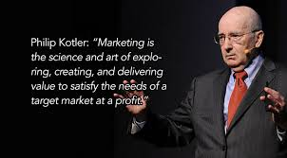
Marketing

Slide 4
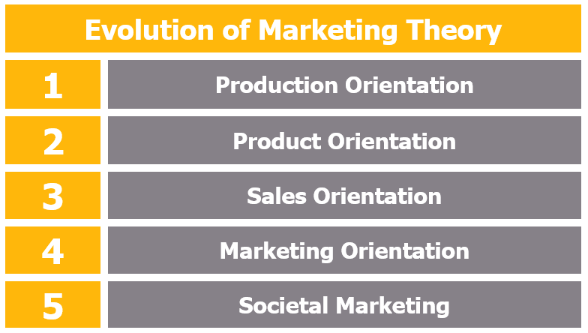
Evolution of Marketing

Slide 5
The Evolution of Marketing
The Production Era-more production and less expensive distribution and storage
The Product Era-This era brought about marketing beliefs that consumers will favor those products that offer the most quality, performance or innovative features. Marketing managers focus on making superior products and improving them over time.

Slide 6
Evolution of Marketing Cont’d
The Selling Era -selling and advertising to persuade consumers
The Marketing Concept Era- customer orientation, service orientation, profit orientation
The Societal Marketing Era emphasizes on social responsibilities and suggests that to sustain long-term success, the company should develop a marketing strategy to provide value to the customers to maintain and improve both the customers and society’s well being better than the competitors.

Slide 7
DEVELOPING a PRODUCT
  Physical Product 4 Marketing Mix
  Product -- A good, service, or idea that satisfies a consumer’s want or need.
  Price -- consider the costs of producing, distributing and promoting the product, which all influence the price.
  Promotion -- advertising, personal selling; public relations, publicity; word of mouth and various sales promotion efforts.
  Place -- Getting the product to consumers when and where they want is critical to market success
  Brand Name -- A word, letter, or a group of words or letters that differentiates one seller’s goods from a competitor’s.
*
LG2
13-

Slide 8
Service 3 Marketing Mix
People :
The role of the service employee becomes much more critical since to a very real extent the employee is the service, given the absence of any tangible artifact. They carry the responsibility of projecting the image of the service firm.
Physical Evidence :
Physical evidence of service includes all the tangible representations of service such as clear signage, good ventilation, adequate space, internet presence, equipment and facility. As services are intangible, customers are searching for any tangible cues to help them understand the nature of the service experience
Process :
Process is referred to as the procedures, mechanisms and flow of activities by which the service isdelivered i.e. the service delivery and operating systems.

Slide 9




BUSINESS-to-BUSINESS
MARKET (B2B)
*
*
  B2B marketers include:
    Manufacturers
    Wholesalers and retailers
    Hospitals, schools and charities
    Government
  Products are often sold and resold several times before reaching final consumers.
13-
Notes:
See Learning Goal 6: Compare the business-to-business market and the consumer market.

Slide 10
Business-to-Consumer Market
The term business-to-consumer (B2C) refers to the process of selling products and services directly between a business and consumers who are the end-users of its products or services. Most companies that sell directly to consumers can be referred to as B2C companies.

Slide 11
Differences between B2B and B2C
Customer Lifetime Value in B2B relationships tends to be long term and strategic. B2B companies often offer complex products or services that require ongoing support and maintenance. As a result, B2B customers usually have a higher LTV because they make repeat purchases over time, often involving larger transaction values.
In contrast, B2C transactions are typically more transactional and shorter in duration, resulting in lower LTV, as consumers may not return frequently for repeat purchases

